Slide 1
BFS

Slide 2
TOPICS
Breadth First Search (BFS)

Slide 3
BREADTH FIRST SEARCH

Slide 4
Graph Searching
Given: a graph G = (V, E), directed or undirected.
Goal: methodically explore (or visit) every vertex.
There are two standard graph traversal techniques:
Breadth-First Search (BFS)
Depth-First Search (DFS)
You will be requiring these two algorithms in the future too:
Learning algorithms like Backtracking
In Courses like Artificial Intelligence, DSA – II, etc.
Developing software

Slide 5
Breadth-First Search
Building a tree over the graph (parent array)
We will pick a source vertex to be the root
We will find (“discover”) its children, then their children, etc.
Associating colors (colors array)
White vertices have not been discovered : All vertices start out white
Grey vertices are discovered but not fully explored :They may be adjacent to white vertices. Enqueuing will be done for these vertices.
Black vertices are discovered and fully explored: They are adjacent only to black and grey vertices
Keeping track of distance from the root (distance array)
Helps in determining how far a vertex is from the root
Using a queue (array based queue/ linked list based queue)
Will be used for guiding the exploration

Slide 6
BFS Simulation
We can use arrays like before for this even though
the vertices are represented by characters
(use the ASCII values)
r
s
t
u
∞
∞
∞
∞
properties | r | s | t | u | v | w | x | Y
d | inf | inf | inf | inf | inf | inf | inf | inf
P | -1 | -1 | -1 | -1 | -1 | -1 | -1 | -1
c | w | w | w | w | w | w | w | W
∞
∞
∞
∞
v
w
x
y
Q
Initial vertex condition
all the vertices will be at infinite distance from the source (source not picked yet).
All the vertices will be colored w (not bee discovered)
They will have no parent
An empty Queue

Slide 7
BFS Simulation
r
s
t
u
∞
∞
∞
∞
properties | r | s | t | u | v | w | x | Y
d | inf | inf | inf | inf | inf | inf | inf | inf
P | -1 | -1 | -1 | -1 | -1 | -1 | -1 | -1
c | w | w | w | w | w | w | w | W
∞
∞
∞
∞
v
w
x
y
Q
Let us take s as the source for this example.
We will now update its attributes

Slide 8
BFS Simulation
r
s
t
u
∞
0
∞
∞
properties | r | s | t | u | v | w | x | Y
d | inf | 0 | inf | inf | inf | inf | inf | inf
P | -1 | -1 | -1 | -1 | -1 | -1 | -1 | -1
c | w | g | w | w | w | w | w | W
∞
∞
∞
∞
v
w
x
y
Q
s
Let us take s as the source for this example.
We will now update its attributes
Distance (from source) = 0 (as s itself is the source)
Parent = -1 (no parent)
Color=gray (discovered) . We are placing gray/discovered vertices in the queue

Slide 9
BFS Simulation
r
s
t
u
∞
0
∞
∞
properties | r | s | t | u | v | w | x | Y
d | inf | 0 | inf | inf | inf | inf | inf | inf
P | -1 | -1 | -1 | -1 | -1 | -1 | -1 | -1
c | w | g | w | w | w | w | w | W
∞
∞
∞
∞
v
w
x
y
Q
s
Let us take s as the source for this example.
We will now update its attributes
Distance (from source) = 0 (as s itself is the source)
Parent = -1 (no parent)
Color=gray (discovered) . We are placing gray/discovered vertices in the queue

Slide 10
BFS Simulation
r
s
t
u
∞
0
∞
∞
properties | r | s | t | u | v | w | x | Y
d | inf | 0 | inf | inf | inf | inf | inf | inf
P | -1 | -1 | -1 | -1 | -1 | -1 | -1 | -1
c | w | g | w | w | w | w | w | W
∞
∞
∞
∞
v
w
x
y
Q
s
Now keep on doing the following until the queue is empty
Take out the topmost element
Visit each of its neighbors
If the neighbors are undiscovered (white)
Mark them as discovered (color them with GRAY color and place them in queue)
Update their distance, parent.
Mark the taken out element as explored (Black – all its children has been discovered)

Slide 11
BFS Simulation
r
s
t
u
∞
0
∞
∞
properties | r | s | t | u | v | w | x | Y
d | inf | 0 | inf | inf | inf | inf | inf | inf
P | -1 | -1 | -1 | -1 | -1 | -1 | -1 | -1
c | w | g | w | w | w | w | w | W
∞
∞
∞
∞
v
w
x
y
Q
s
Now keep on doing the following until the queue is empty
Take out the topmost element
Visit each of its neighbors
If the neighbors are undiscovered (white)
Mark them as discovered (color them with GRAY color and place them in queue)
Update their distance, parent.
Mark the taken out element as explored (Black – all its children has been discovered)

Slide 12
BFS Simulation
r
s
t
u
∞
0
∞
∞
properties | r | s | t | u | v | w | x | Y
d | inf | 0 | inf | inf | inf | inf | inf | inf
P | -1 | -1 | -1 | -1 | -1 | -1 | -1 | -1
c | w | g | w | w | w | w | w | W
∞
∞
∞
∞
v
w
x
y
Q
s
Now keep on doing the following until the queue is empty
Take out the topmost element
Visit each of its neighbors
If the neighbors are undiscovered (white)
Mark them as discovered (color them with GRAY color and place them in queue)
Update their distance, parent.
Mark the taken out element as explored (Black – all its children has been discovered)

Slide 13
BFS Simulation
r
s
t
u
1
0
∞
∞
properties | r | s | t | u | v | w | x | Y
d | 1 | 0 | inf | inf | inf | 1 | inf | inf
P | s | -1 | -1 | -1 | -1 | s | -1 | -1
c | g | g | w | w | w | g | w | W
∞
1
∞
∞
v
w
x
y
Q
s
Now keep on doing the following until the queue is empty
Take out the topmost element
Visit each of its neighbors
If the neighbors are undiscovered (white)
Mark them as discovered (color them with GRAY color and place them in queue)
Update their distance, parent.
Mark the taken out element as explored (Black – all its children has been discovered)

Slide 14
BFS Simulation
r
s
t
u
1
0
∞
∞
properties | r | s | t | u | v | w | x | Y
d | 1 | 0 | inf | inf | inf | 1 | inf | inf
P | s | -1 | -1 | -1 | -1 | s | -1 | -1
c | g | g | w | w | w | g | w | W
∞
1
∞
∞
v
w
x
y
Q
s
r
w
Now keep on doing the following until the queue is empty
Take out the topmost element
Visit each of its neighbors
If the neighbors are undiscovered (white)
Mark them as discovered (color them with GRAY color and place them in queue)
Update their distance, parent.
Mark the taken out element as explored (Black – all its children has been discovered)

Slide 15
BFS Simulation
r
s
t
u
1
0
∞
∞
properties | r | s | t | u | v | w | x | Y
d | 1 | 0 | inf | inf | inf | 1 | inf | inf
P | s | -1 | -1 | -1 | -1 | s | -1 | -1
c | g | g | w | w | w | g | w | W
∞
1
∞
∞
v
w
x
y
Q
s
r
w
Now keep on doing the following until the queue is empty
Take out the topmost element
Visit each of its neighbors
If the neighbors are undiscovered (white)
Mark them as discovered (color them with GRAY color and place them in queue)
Update their distance, parent.
Mark the taken out element as explored (Black – all its children has been discovered)

Slide 16
BFS Simulation
r
s
t
u
1
0
∞
∞
properties | r | s | t | u | v | w | x | Y
d | 1 | 0 | inf | inf | inf | 1 | inf | inf
P | s | -1 | -1 | -1 | -1 | S | -1 | -1
c | g | g | w | w | w | g | w | W
∞
1
∞
∞
v
w
x
y
Q
s
r
w
Now keep on doing the following until the queue is empty
Take out the topmost element
Visit each of its neighbors
If the neighbors are undiscovered (white)
Mark them as discovered (color them with GRAY color and place them in queue)
Update their distance, parent.
Mark the taken out element as explored (Black – all its children has been discovered)

Slide 17
BFS Simulation
r
s
t
u
1
0
∞
∞
properties | r | s | t | u | v | w | x | Y
d | 1 | 0 | inf | inf | inf | 1 | inf | inf
P | S | -1 | -1 | -1 | -1 | S | -1 | -1
c | g | b | w | w | w | g | w | W
∞
1
∞
∞
v
w
x
y
Q
r
w
Now keep on doing the following until the queue is empty
Take out the topmost element
Visit each of its neighbors
If the neighbors are undiscovered (white)
Mark them as discovered (color them with GRAY color and place them in queue)
Update their distance, parent.
Mark the taken out element as explored (Black – all its children has been discovered)

Slide 18
BFS Simulation
r
s
t
u
1
0
∞
∞
properties | r | s | t | u | v | w | x | Y
d | 1 | 0 | inf | inf | inf | 1 | inf | inf
P | s | -1 | -1 | -1 | -1 | s | -1 | -1
c | g | b | w | w | w | g | w | W
∞
1
∞
∞
v
w
x
y
Q
r
w
Now keep on doing the following until the queue is empty
Take out the topmost element
Visit each of its neighbors
If the neighbors are undiscovered (white)
Mark them as discovered (color them with GRAY color and place them in queue)
Update their distance, parent.
Mark the taken out element as explored (Black – all its children has been discovered)

Slide 19
BFS Simulation
r
s
t
u
1
0
∞
∞
properties | r | s | t | u | v | w | x | Y
d | 1 | 0 | inf | inf | inf | 1 | inf | inf
P | s | -1 | -1 | -1 | -1 | s | -1 | -1
c | g | b | w | w | w | g | w | W
∞
1
∞
∞
v
w
x
y
Q
r
w
Now keep on doing the following until the queue is empty
Take out the topmost element
Visit each of its neighbors
If the neighbors are undiscovered (white)
Mark them as discovered (color them with GRAY color and place them in queue)
Update their distance, parent.
Mark the taken out element as explored (Black – all its children has been discovered)

Slide 20
BFS Simulation
r
s
t
u
1
0
∞
∞
properties | r | s | t | u | v | w | x | Y
d | 1 | 0 | inf | inf | inf | 1 | inf | inf
P | s | -1 | -1 | -1 | -1 | s | -1 | -1
c | g | b | w | w | w | g | w | W
∞
1
∞
∞
v
w
x
y
Q
r
w
Now keep on doing the following until the queue is empty
Take out the topmost element
Visit each of its neighbors
If the neighbors are undiscovered (white)
Mark them as discovered (color them with GRAY color and place them in queue)
Update their distance, parent.
Mark the taken out element as explored (Black – all its children has been discovered)

Slide 21
BFS Simulation
r
s
t
u
1
0
∞
∞
properties | r | s | t | u | v | w | x | Y
d | 1 | 0 | inf | inf | 2 | 1 | inf | inf
P | s | -1 | -1 | -1 | 1 | s | -1 | -1
c | g | b | w | w | g | g | w | W
2
1
∞
∞
v
w
x
y
Q
r
w
v
Now keep on doing the following until the queue is empty
Take out the topmost element
Visit each of its neighbors
If the neighbors are undiscovered (white)
Mark them as discovered (color them with GRAY color and place them in queue)
Update their distance, parent.
Mark the taken out element as explored (Black – all its children has been discovered)

Slide 22
BFS Simulation
r
s
t
u
1
0
∞
∞
properties | r | s | t | u | v | w | x | Y
d | 1 | 0 | inf | inf | 2 | 1 | inf | inf
P | s | -1 | -1 | -1 | 1 | s | -1 | -1
c | b | b | w | w | g | g | w | W
2
1
∞
∞
v
w
x
y
Q
r
w
v
Now keep on doing the following until the queue is empty
Take out the topmost element
Visit each of its neighbors
If the neighbors are undiscovered (white)
Mark them as discovered (color them with GRAY color and place them in queue)
Update their distance, parent.
Mark the taken out element as explored (Black – all its children has been discovered)

Slide 23
BFS Simulation
r
s
t
u
1
0
∞
∞
properties | r | s | t | u | v | w | x | Y
d | 1 | 0 | inf | inf | 2 | 1 | inf | inf
P | s | -1 | -1 | -1 | 1 | s | -1 | -1
c | b | b | w | w | g | g | w | W
2
1
∞
∞
v
w
x
y
Q
w
v
Now keep on doing the following until the queue is empty
Take out the topmost element
Visit each of its neighbors
If the neighbors are undiscovered (white)
Mark them as discovered (color them with GRAY color and place them in queue)
Update their distance, parent.
Mark the taken out element as explored (Black – all its children has been discovered)

Slide 24
BFS Simulation
r
s
t
u
1
0
∞
∞
properties | r | s | t | u | v | w | x | Y
d | 1 | 0 | inf | inf | 2 | 1 | inf | inf
P | s | -1 | -1 | -1 | 1 | s | -1 | -1
c | b | b | w | w | g | g | w | W
2
1
∞
∞
v
w
x
y
Q
w
v
Now keep on doing the following until the queue is empty
Take out the topmost element
Visit each of its neighbors
If the neighbors are undiscovered (white)
Mark them as discovered (color them with GRAY color and place them in queue)
Update their distance, parent.
Mark the taken out element as explored (Black – all its children has been discovered)

Slide 25
BFS Simulation
r
s
t
u
1
0
∞
∞
properties | r | s | t | u | v | w | x | Y
d | 1 | 0 | inf | inf | 2 | 1 | inf | inf
P | s | -1 | -1 | -1 | 1 | s | -1 | -1
c | b | b | w | w | g | g | w | W
2
1
∞
∞
v
w
x
y
Q
w
v
Now keep on doing the following until the queue is empty
Take out the topmost element
Visit each of its neighbors
If the neighbors are undiscovered (white)
Mark them as discovered (color them with GRAY color and place them in queue)
Update their distance, parent.
Mark the taken out element as explored (Black – all its children has been discovered)

Slide 26
BFS Simulation
r
s
t
u
1
0
2
∞
properties | r | s | t | u | v | w | x | Y
d | 1 | 0 | 2 | inf | 2 | 1 | 2 | inf
P | s | -1 | w | -1 | 1 | s | w | -1
c | b | b | g | w | g | g | g | w
2
1
2
∞
v
w
x
y
Q
w
v
Now keep on doing the following until the queue is empty
Take out the topmost element
Visit each of its neighbors
If the neighbors are undiscovered (white)
Mark them as discovered (color them with GRAY color and place them in queue)
Update their distance, parent.
Mark the taken out element as explored (Black – all its children has been discovered)

Slide 27
BFS Simulation
r
s
t
u
1
0
2
∞
properties | r | s | t | u | v | w | x | Y
d | 1 | 0 | 2 | inf | 2 | 1 | 2 | inf
P | s | -1 | w | -1 | 1 | s | w | -1
c | b | b | g | w | g | g | g | w
2
1
2
∞
v
w
x
y
Q
w
v
t
x
Now keep on doing the following until the queue is empty
Take out the topmost element
Visit each of its neighbors
If the neighbors are undiscovered (white)
Mark them as discovered (color them with GRAY color and place them in queue)
Update their distance, parent.
Mark the taken out element as explored (Black – all its children has been discovered)

Slide 28
BFS Simulation
r
s
t
u
1
0
2
∞
properties | r | s | t | u | v | w | x | Y
d | 1 | 0 | 2 | inf | 2 | 1 | 2 | inf
P | s | -1 | w | -1 | 1 | s | w | -1
c | b | b | g | w | g | b | g | w
2
1
2
∞
v
w
x
y
Q
v
t
x
Now keep on doing the following until the queue is empty
Take out the topmost element
Visit each of its neighbors
If the neighbors are undiscovered (white)
Mark them as discovered (color them with GRAY color and place them in queue)
Update their distance, parent.
Mark the taken out element as explored (Black – all its children has been discovered)

Slide 29
BFS Simulation
r
s
t
u
1
0
2
∞
properties | r | s | t | u | v | w | x | Y
d | 1 | 0 | 2 | inf | 2 | 1 | 2 | inf
P | s | -1 | w | -1 | 1 | s | w | -1
c | b | b | g | w | g | b | g | w
2
1
2
∞
v
w
x
y
Q
v
t
x
Now keep on doing the following until the queue is empty
Take out the topmost element
Visit each of its neighbors
If the neighbors are undiscovered (white)
Mark them as discovered (color them with GRAY color and place them in queue)
Update their distance, parent.
Mark the taken out element as explored (Black – all its children has been discovered)

Slide 30
BFS Simulation
r
s
t
u
1
0
2
∞
properties | r | s | t | u | v | w | x | Y
d | 1 | 0 | 2 | inf | 2 | 1 | 2 | inf
P | s | -1 | w | -1 | 1 | s | w | -1
c | b | b | g | w | g | b | g | w
2
1
2
∞
v
w
x
y
Q
v
t
x
Now keep on doing the following until the queue is empty
Take out the topmost element
Visit each of its neighbors
If the neighbors are undiscovered (white)
Mark them as discovered (color them with GRAY color and place them in queue)
Update their distance, parent.
Mark the taken out element as explored (Black – all its children has been discovered)

Slide 31
BFS Simulation
r
s
t
u
1
0
2
∞
properties | r | s | t | u | v | w | x | Y
d | 1 | 0 | 2 | inf | 2 | 1 | 2 | inf
P | s | -1 | w | -1 | 1 | s | w | -1
c | b | b | g | w | g | b | g | w
2
1
2
∞
v
w
x
y
Q
v
t
x
Now keep on doing the following until the queue is empty
Take out the topmost element
Visit each of its neighbors
If the neighbors are undiscovered (white)
Mark them as discovered (color them with GRAY color and place them in queue)
Update their distance, parent.
Mark the taken out element as explored (Black – all its children has been discovered)

Slide 32
BFS Simulation
r
s
t
u
1
0
2
∞
properties | r | s | t | u | v | w | x | Y
d | 1 | 0 | 2 | inf | 2 | 1 | 2 | inf
P | s | -1 | w | -1 | 1 | s | w | -1
c | b | b | g | w | g | b | g | w
2
1
2
∞
v
w
x
y
Q
v
t
x
Now keep on doing the following until the queue is empty
Take out the topmost element
Visit each of its neighbors
If the neighbors are undiscovered (white)
Mark them as discovered (color them with GRAY color and place them in queue)
Update their distance, parent.
Mark the taken out element as explored (Black – all its children has been discovered)

Slide 33
BFS Simulation
r
s
t
u
1
0
2
∞
properties | r | s | t | u | v | w | x | Y
d | 1 | 0 | 2 | inf | 2 | 1 | 2 | inf
P | s | -1 | w | -1 | 1 | s | w | -1
c | b | b | g | w | b | b | g | w
2
1
2
∞
v
w
x
y
Q
v
t
x
Now keep on doing the following until the queue is empty
Take out the topmost element
Visit each of its neighbors
If the neighbors are undiscovered (white)
Mark them as discovered (color them with GRAY color and place them in queue)
Update their distance, parent.
Mark the taken out element as explored (Black – all its children has been discovered)

Slide 34
BFS Simulation
r
s
t
u
1
0
2
∞
properties | r | s | t | u | v | w | x | Y
d | 1 | 0 | 2 | inf | 2 | 1 | 2 | inf
P | s | -1 | w | -1 | 1 | s | w | -1
c | b | b | g | w | b | b | g | w
2
1
2
∞
v
w
x
y
Q
t
x
Now keep on doing the following until the queue is empty
Take out the topmost element
Visit each of its neighbors
If the neighbors are undiscovered (white)
Mark them as discovered (color them with GRAY color and place them in queue)
Update their distance, parent.
Mark the taken out element as explored (Black – all its children has been discovered)

Slide 35
BFS Simulation
r
s
t
u
1
0
2
∞
properties | r | s | t | u | v | w | x | Y
d | 1 | 0 | 2 | inf | 2 | 1 | 2 | inf
P | s | -1 | w | -1 | 1 | s | w | -1
c | b | b | g | w | b | b | g | w
2
1
2
∞
v
w
x
y
Q
t
x
Now keep on doing the following until the queue is empty
Take out the topmost element
Visit each of its neighbors
If the neighbors are undiscovered (white)
Mark them as discovered (color them with GRAY color and place them in queue)
Update their distance, parent.
Mark the taken out element as explored (Black – all its children has been discovered)

Slide 36
BFS Simulation
r
s
t
u
1
0
2
∞
properties | r | s | t | u | v | w | x | Y
d | 1 | 0 | 2 | inf | 2 | 1 | 2 | inf
P | s | -1 | w | -1 | 1 | s | w | -1
c | b | b | g | w | b | b | g | w
2
1
2
∞
v
w
x
y
Q
t
x
Now keep on doing the following until the queue is empty
Take out the topmost element
Visit each of its neighbors
If the neighbors are undiscovered (white)
Mark them as discovered (color them with GRAY color and place them in queue)
Update their distance, parent.
Mark the taken out element as explored (Black – all its children has been discovered)

Slide 37
BFS Simulation
r
s
t
u
1
0
2
∞
properties | r | s | t | u | v | w | x | Y
d | 1 | 0 | 2 | inf | 2 | 1 | 2 | inf
P | s | -1 | w | -1 | 1 | s | w | -1
c | b | b | g | w | b | b | g | w
2
1
2
∞
v
w
x
y
Q
t
x
Now keep on doing the following until the queue is empty
Take out the topmost element
Visit each of its neighbors
If the neighbors are undiscovered (white)
Mark them as discovered (color them with GRAY color and place them in queue)
Update their distance, parent.
Mark the taken out element as explored (Black – all its children has been discovered)

Slide 38
BFS Simulation
r
s
t
u
1
0
2
3
properties | r | s | t | u | v | w | x | Y
d | 1 | 0 | 2 | 3 | 2 | 1 | 2 | inf
P | s | -1 | w | t | 1 | s | w | -1
c | b | b | g | g | b | b | g | w
2
1
2
∞
v
w
x
y
Q
t
x
u
Now keep on doing the following until the queue is empty
Take out the topmost element
Visit each of its neighbors
If the neighbors are undiscovered (white)
Mark them as discovered (color them with GRAY color and place them in queue)
Update their distance, parent.
Mark the taken out element as explored (Black – all its children has been discovered)

Slide 39
BFS Simulation
r
s
t
u
1
0
2
3
properties | r | s | t | u | v | w | x | Y
d | 1 | 0 | 2 | 3 | 2 | 1 | 2 | inf
P | s | -1 | w | t | 1 | s | w | -1
c | b | b | b | g | b | b | g | w
2
1
2
∞
v
w
x
y
Q
t
x
u
Now keep on doing the following until the queue is empty
Take out the topmost element
Visit each of its neighbors
If the neighbors are undiscovered (white)
Mark them as discovered (color them with GRAY color and place them in queue)
Update their distance, parent.
Mark the taken out element as explored (Black – all its children has been discovered)

Slide 40
BFS Simulation
r
s
t
u
1
0
2
3
properties | r | s | t | u | v | w | x | Y
d | 1 | 0 | 2 | 3 | 2 | 1 | 2 | inf
P | s | -1 | w | t | 1 | s | w | -1
c | b | b | b | g | b | b | g | w
2
1
2
∞
v
w
x
y
Q
x
u
Now keep on doing the following until the queue is empty
Take out the topmost element
Visit each of its neighbors
If the neighbors are undiscovered (white)
Mark them as discovered (color them with GRAY color and place them in queue)
Update their distance, parent.
Mark the taken out element as explored (Black – all its children has been discovered)

Slide 41
BFS Simulation
r
s
t
u
1
0
2
3
properties | r | s | t | u | v | w | x | Y
d | 1 | 0 | 2 | 3 | 2 | 1 | 2 | inf
P | s | -1 | w | t | 1 | s | w | -1
c | b | b | b | g | b | b | g | w
2
1
2
∞
v
w
x
y
Q
x
u
Now keep on doing the following until the queue is empty
Take out the topmost element
Visit each of its neighbors
If the neighbors are undiscovered (white)
Mark them as discovered (color them with GRAY color and place them in queue)
Update their distance, parent.
Mark the taken out element as explored (Black – all its children has been discovered)

Slide 42
BFS Simulation
r
s
t
u
1
0
2
3
properties | r | s | t | u | v | w | x | Y
d | 1 | 0 | 2 | 3 | 2 | 1 | 2 | inf
P | s | -1 | w | t | 1 | s | w | -1
c | b | b | b | g | b | b | g | w
2
1
2
∞
v
w
x
y
Q
x
u
Now keep on doing the following until the queue is empty
Take out the topmost element
Visit each of its neighbors
If the neighbors are undiscovered (white)
Mark them as discovered (color them with GRAY color and place them in queue)
Update their distance, parent.
Mark the taken out element as explored (Black – all its children has been discovered)

Slide 43
BFS Simulation
r
s
t
u
1
0
2
3
properties | r | s | t | u | v | w | x | Y
d | 1 | 0 | 2 | 3 | 2 | 1 | 2 | inf
P | s | -1 | w | t | 1 | s | w | -1
c | b | b | b | g | b | b | g | w
2
1
2
∞
v
w
x
y
Q
x
u
Now keep on doing the following until the queue is empty
Take out the topmost element
Visit each of its neighbors
If the neighbors are undiscovered (white)
Mark them as discovered (color them with GRAY color and place them in queue)
Update their distance, parent.
Mark the taken out element as explored (Black – all its children has been discovered)

Slide 44
BFS Simulation
r
s
t
u
1
0
2
3
properties | r | s | t | u | v | w | x | Y
d | 1 | 0 | 2 | 3 | 2 | 1 | 2 | inf
P | s | -1 | w | t | 1 | s | w | -1
c | b | b | b | g | b | b | g | w
2
1
2
∞
v
w
x
y
Q
x
u
Now keep on doing the following until the queue is empty
Take out the topmost element
Visit each of its neighbors
If the neighbors are undiscovered (white)
Mark them as discovered (color them with GRAY color and place them in queue)
Update their distance, parent.
Mark the taken out element as explored (Black – all its children has been discovered)

Slide 45
BFS Simulation
r
s
t
u
1
0
2
3
properties | r | s | t | u | v | w | x | Y
d | 1 | 0 | 2 | 3 | 2 | 1 | 2 | 3
P | s | -1 | w | t | 1 | s | w | X
c | b | b | b | g | b | b | g | g
2
1
2
3
v
w
x
y
Q
x
u
y
Now keep on doing the following until the queue is empty
Take out the topmost element
Visit each of its neighbors
If the neighbors are undiscovered (white)
Mark them as discovered (color them with GRAY color and place them in queue)
Update their distance, parent.
Mark the taken out element as explored (Black – all its children has been discovered)

Slide 46
BFS Simulation
r
s
t
u
1
0
2
3
properties | r | s | t | u | v | w | x | Y
d | 1 | 0 | 2 | 3 | 2 | 1 | 2 | 3
P | s | -1 | w | t | 1 | s | w | X
c | b | b | b | g | b | b | b | g
2
1
2
3
v
w
x
y
Q
x
u
y
Now keep on doing the following until the queue is empty
Take out the topmost element
Visit each of its neighbors
If the neighbors are undiscovered (white)
Mark them as discovered (color them with GRAY color and place them in queue)
Update their distance, parent.
Mark the taken out element as explored (Black – all its children has been discovered)

Slide 47
BFS Simulation
r
s
t
u
1
0
2
3
properties | r | s | t | u | v | w | x | Y
d | 1 | 0 | 2 | 3 | 2 | 1 | 2 | 3
P | s | -1 | w | t | 1 | s | w | X
c | b | b | b | g | b | b | b | g
2
1
2
3
v
w
x
y
Q
u
y
Now keep on doing the following until the queue is empty
Take out the topmost element
Visit each of its neighbors
If the neighbors are undiscovered (white)
Mark them as discovered (color them with GRAY color and place them in queue)
Update their distance, parent.
Mark the taken out element as explored (Black – all its children has been discovered)

Slide 48
BFS Simulation
r
s
t
u
1
0
2
3
properties | r | s | t | u | v | w | x | Y
d | 1 | 0 | 2 | 3 | 2 | 1 | 2 | 3
P | s | -1 | w | t | 1 | s | w | X
c | b | b | b | g | b | b | b | g
2
1
2
3
v
w
x
y
Q
u
y
Now keep on doing the following until the queue is empty
Take out the topmost element
Visit each of its neighbors
If the neighbors are undiscovered (white)
Mark them as discovered (color them with GRAY color and place them in queue)
Update their distance, parent.
Mark the taken out element as explored (Black – all its children has been discovered)

Slide 49
BFS Simulation
r
s
t
u
1
0
2
3
properties | r | s | t | u | v | w | x | Y
d | 1 | 0 | 2 | 3 | 2 | 1 | 2 | 3
P | s | -1 | w | t | 1 | s | w | X
c | b | b | b | g | b | b | b | g
2
1
2
3
v
w
x
y
Q
u
y
Now keep on doing the following until the queue is empty
Take out the topmost element
Visit each of its neighbors
If the neighbors are undiscovered (white)
Mark them as discovered (color them with GRAY color and place them in queue)
Update their distance, parent.
Mark the taken out element as explored (Black – all its children has been discovered)

Slide 50
BFS Simulation
r
s
t
u
1
0
2
3
properties | r | s | t | u | v | w | x | Y
d | 1 | 0 | 2 | 3 | 2 | 1 | 2 | 3
P | s | -1 | w | t | 1 | s | w | X
c | b | b | b | g | b | b | b | g
2
1
2
3
v
w
x
y
Q
u
y
Now keep on doing the following until the queue is empty
Take out the topmost element
Visit each of its neighbors
If the neighbors are undiscovered (white)
Mark them as discovered (color them with GRAY color and place them in queue)
Update their distance, parent.
Mark the taken out element as explored (Black – all its children has been discovered)

Slide 51
BFS Simulation
r
s
t
u
1
0
2
3
properties | r | s | t | u | v | w | x | Y
d | 1 | 0 | 2 | 3 | 2 | 1 | 2 | 3
P | s | -1 | w | t | 1 | s | w | X
c | b | b | b | b | b | b | b | g
2
1
2
3
v
w
x
y
Q
u
y
Now keep on doing the following until the queue is empty
Take out the topmost element
Visit each of its neighbors
If the neighbors are undiscovered (white)
Mark them as discovered (color them with GRAY color and place them in queue)
Update their distance, parent.
Mark the taken out element as explored (Black – all its children has been discovered)

Slide 52
BFS Simulation
r
s
t
u
1
0
2
3
properties | r | s | t | u | v | w | x | Y
d | 1 | 0 | 2 | 3 | 2 | 1 | 2 | 3
P | s | -1 | w | t | 1 | s | w | X
c | b | b | b | b | b | b | b | g
2
1
2
3
v
w
x
y
Q
y
Now keep on doing the following until the queue is empty
Take out the topmost element
Visit each of its neighbors
If the neighbors are undiscovered (white)
Mark them as discovered (color them with GRAY color and place them in queue)
Update their distance, parent.
Mark the taken out element as explored (Black – all its children has been discovered)

Slide 53
BFS Simulation
r
s
t
u
1
0
2
3
properties | r | s | t | u | v | w | x | Y
d | 1 | 0 | 2 | 3 | 2 | 1 | 2 | 3
P | s | -1 | w | t | 1 | s | w | X
c | b | b | b | b | b | b | b | g
2
1
2
3
v
w
x
y
Q
y
Now keep on doing the following until the queue is empty
Take out the topmost element
Visit each of its neighbors
If the neighbors are undiscovered (white)
Mark them as discovered (color them with GRAY color and place them in queue)
Update their distance, parent.
Mark the taken out element as explored (Black – all its children has been discovered)

Slide 54
BFS Simulation
r
s
t
u
1
0
2
3
properties | r | s | t | u | v | w | x | Y
d | 1 | 0 | 2 | 3 | 2 | 1 | 2 | 3
P | s | -1 | w | t | 1 | s | w | X
c | b | b | b | b | b | b | b | g
2
1
2
3
v
w
x
y
Q
y
Now keep on doing the following until the queue is empty
Take out the topmost element
Visit each of its neighbors
If the neighbors are undiscovered (white)
Mark them as discovered (color them with GRAY color and place them in queue)
Update their distance, parent.
Mark the taken out element as explored (Black – all its children has been discovered)

Slide 55
BFS Simulation
r
s
t
u
1
0
2
3
properties | r | s | t | u | v | w | x | Y
d | 1 | 0 | 2 | 3 | 2 | 1 | 2 | 3
P | s | -1 | w | t | 1 | s | w | X
c | b | b | b | b | b | b | b | g
2
1
2
3
v
w
x
y
Q
y
Now keep on doing the following until the queue is empty
Take out the topmost element
Visit each of its neighbors
If the neighbors are undiscovered (white)
Mark them as discovered (color them with GRAY color and place them in queue)
Update their distance, parent.
Mark the taken out element as explored (Black – all its children has been discovered)

Slide 56
BFS Simulation
r
s
t
u
1
0
2
3
properties | r | s | t | u | v | w | x | Y
d | 1 | 0 | 2 | 3 | 2 | 1 | 2 | 3
P | s | -1 | w | t | 1 | s | w | X
c | b | b | b | b | b | b | b | g
2
1
2
3
v
w
x
y
Q
Now keep on doing the following until the queue is empty
Take out the topmost element
Visit each of its neighbors
If the neighbors are undiscovered (white)
Mark them as discovered (color them with GRAY color and place them in queue)
Update their distance, parent.
Mark the taken out element as explored (Black – all its children has been discovered)

Slide 57
BFS Simulation
r
s
t
u
1
0
2
3
properties | r | s | t | u | v | w | x | Y
d | 1 | 0 | 2 | 3 | 2 | 1 | 2 | 3
P | s | -1 | w | t | 1 | s | w | X
c | b | b | b | b | b | b | b | g
2
1
2
3
v
w
x
y
Q
Now keep on doing the following until the queue is empty
Take out the topmost element
Visit each of its neighbors
If the neighbors are undiscovered (white)
Mark them as discovered (color them with GRAY color and place them in queue)
Update their distance, parent.
Mark the taken out element as explored (Black – all its children has been discovered)

Slide 58
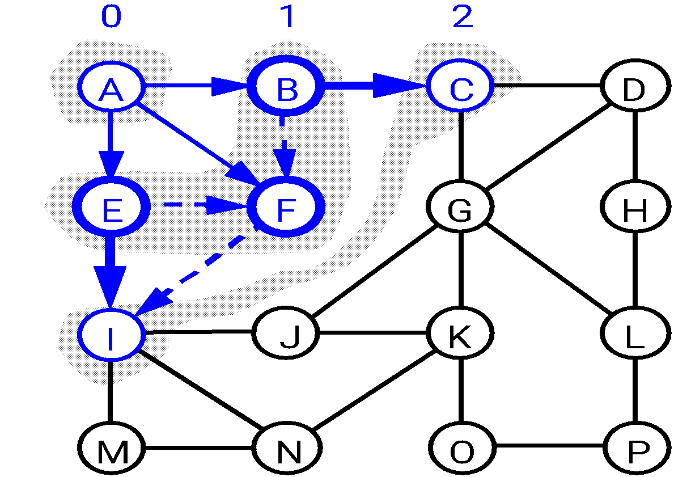
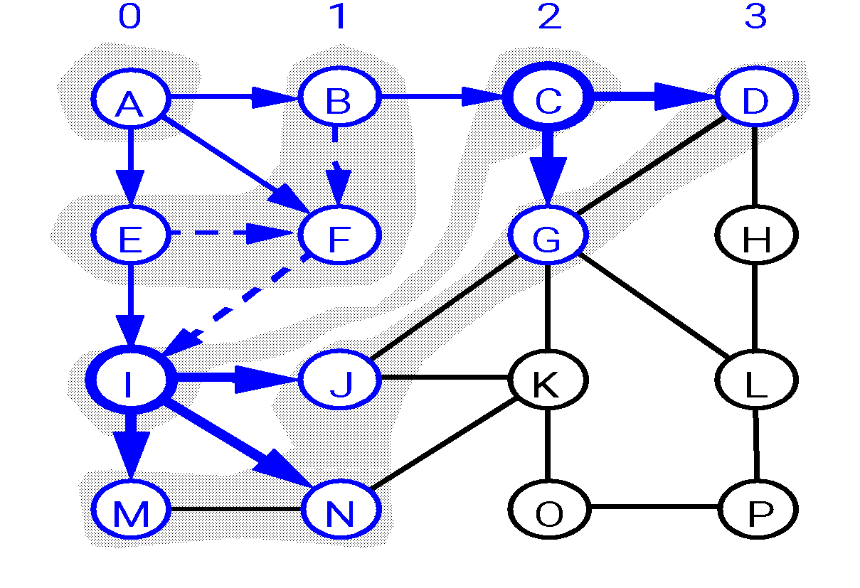
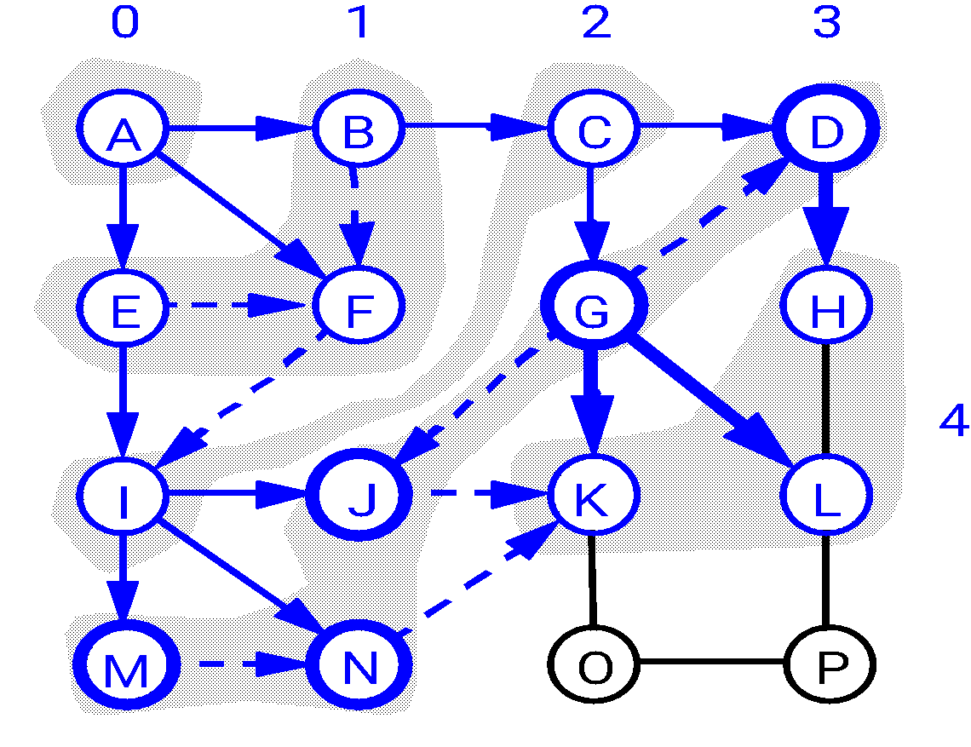
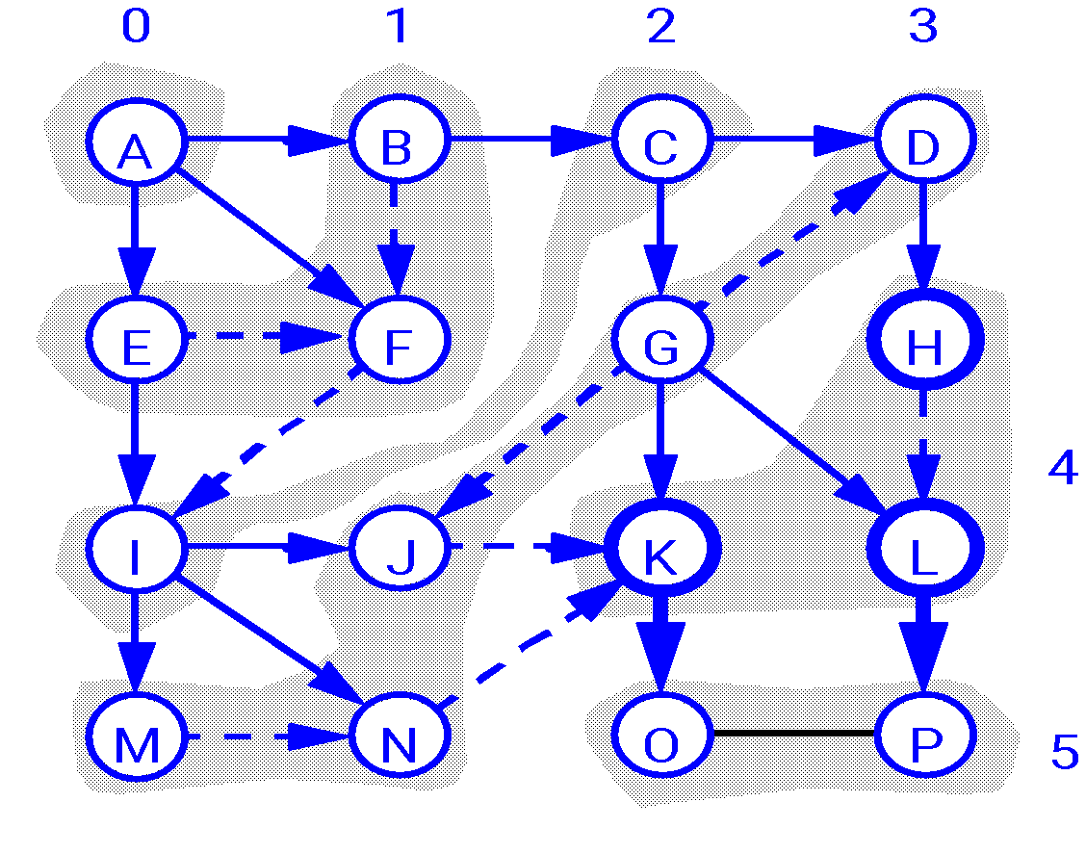
BFS Discovery Pattern
0
0
1
A
B
C
D
A
B
C
D
E
F
G
H
E
F
G
H
I
J
K
L
I
J
K
L
M
N
O
P
M
N
O
P

Slide 59
Breadth-First Search: Properties
BFS calculates the shortest-path along with its distance to the source node
Shortest-path distance δ(s,v) = minimum number of edges from s to v, or ∞ if v not reachable from s
BFS builds breadth-first tree, in which paths to root represent shortest paths in G
Thus can use BFS to calculate shortest path from one vertex to another in O(V+E) time in an unweighted tree

Slide 60
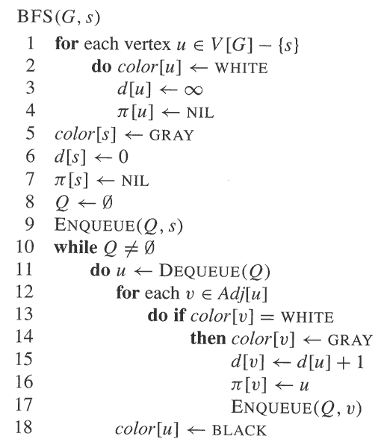
Let us Formulate the BFS Pseudocode

Slide 61
LEVEL ORDER TRAVERSAL

Slide 62
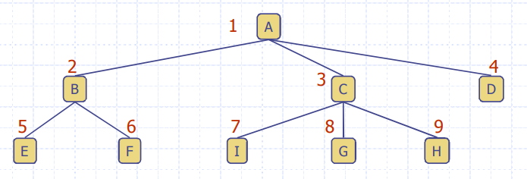
Level order traversal
Run BFS from the root
Print the node when you color it black

Slide 63
Thank You

